Slide 1
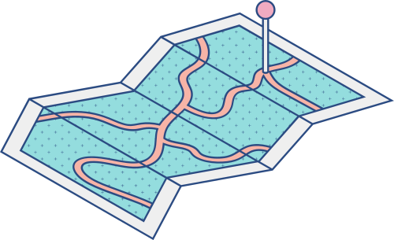





COA PROJECT
Microcontroller Based Applications
Traffic Light Controller
Team Members
Nidhi Barapatre 21BCS146
Saurabh Nagpure 21BCS138
Sadanand Jaiswal 21BCS180

Slide 2

Traffic Light Controller
The use of personal vehicles is increasing nowadays, which leads to an increase in road traffic.
Also, roads without any supervision or guidance can lead to traffic congestion and accidents. Hence, here the traffic lights come into action.
Traffic lights, traffic signals, or stoplights are signaling devices positioned at road intersections, pedestrian crossing, and other locations in order to control the flow of traffic.
An Arduino-based traffic light controller system is designed in this project. It is a simple implementation of the traffic light system but can be extended to a real-time system with programmable timings, pedestrian lighting etc.
The aim of the project is to implement a simple traffic light controller using Arduino MEGA, where the traffic is controlled according to a pre-defined timing system.

Slide 3
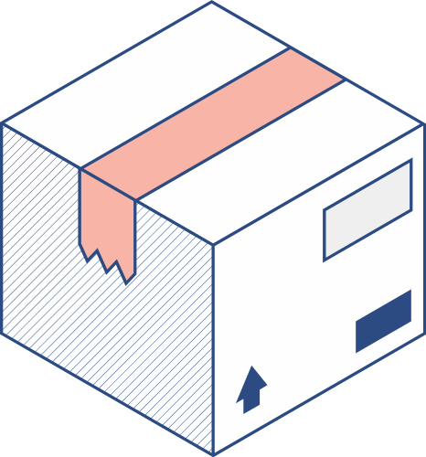


Platform used - Proteus
Arduino MEGA 2560 Push Button Traffic Lights Potentiometer | Ultrasonic Sensor Connecting Wires Grove Ultrasonic Ranger
Components required to make this project are:

Slide 4

We are implementing traffic lights at a 4-way intersection.
The project is a simple representation of a traffic light controller, and hence no other extra components are used.
We need three LEDs of red, yellow, and green at each intersection.
The intersection is divided into four lanes: lane 1, lane 2, lane 3, and lane 4. All the LEDs are connected to the Arduino MEGA’s digital I/O pins through respective current limiting resistors.

Slide 5
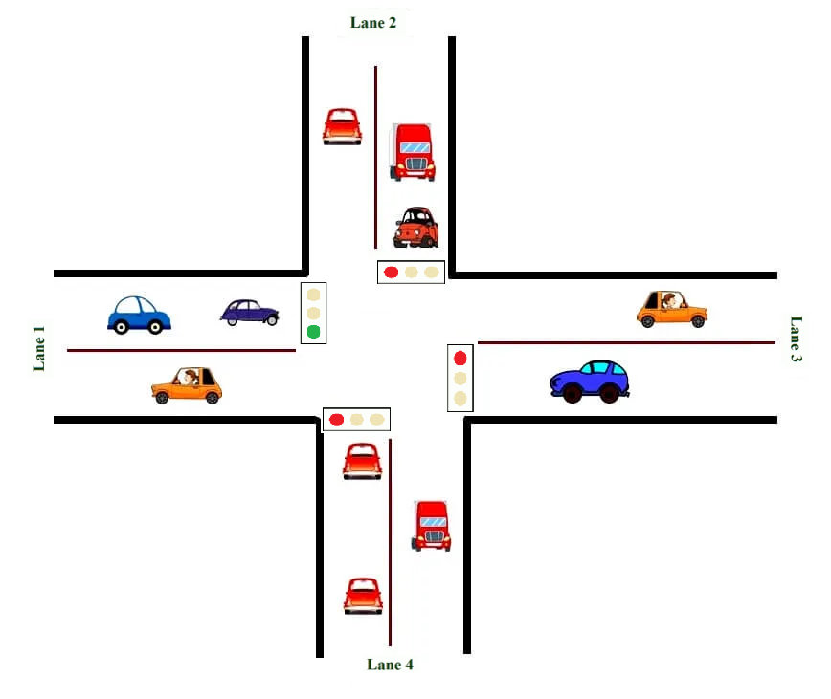

Slide 6

APPLICATIONS
• A simple traffic light controller is made in this project with a real chance of expansion. | • An external memory can be interfaced with the main controller so that the timings are not fixed during its programming but rather can be programmed during operation. | • An efficient traffic light controller system will include a pedestrian signaling system.

Slide 7

The Working of the Traffic Light Controller

Slide 8
In this project, we have made a traffic light system with ultrasonic sensor for a 4-way intersection using Arduino MEGA.
➢ In this, first lane 1 gets its green light turned on. To avoid clashes with vehicles in other lanes, all the other lane lights will be turned to red. After a fixed time, the green light in lane 3 will be turned to green, the green light in lane 1 will be turned off, and the red light will be turned on.
➢ As a warning indicator, the yellow light in Lane 1 is turned on, indicating that the red light is about to light up. Similarly, the yellow light in Lane 3 is also turned on as an indication that the green light is about to be turned on.
➢ There are pedestrian lights as well. When the pedestrian button is pushed
pedestrian green light is turned on so that people can pass by in any direction.

Slide 9
➢ Ultrasonic sensor rotates 360 degrees and send ultrasonic waves in the 4 lanes. Ultrasonic waves strike the vehicles and bounce back. It measures both the density of vehicles and distance
travelled by the ultrasonic waves.
➢ If the distance travelled is more then the green light is turned on for a longer time .If the distance travelled is less then the green light is turned on for a lesser time.

Slide 10
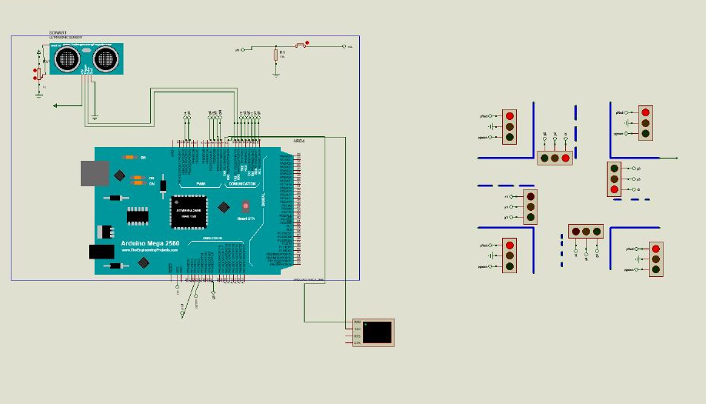
Circuit Diagram

Slide 11
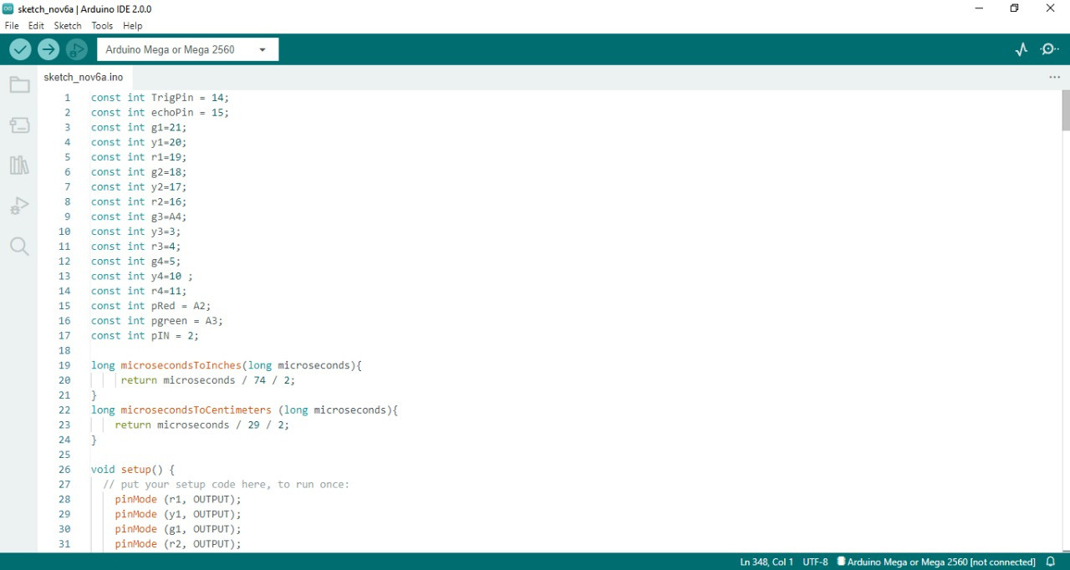

Slide 12
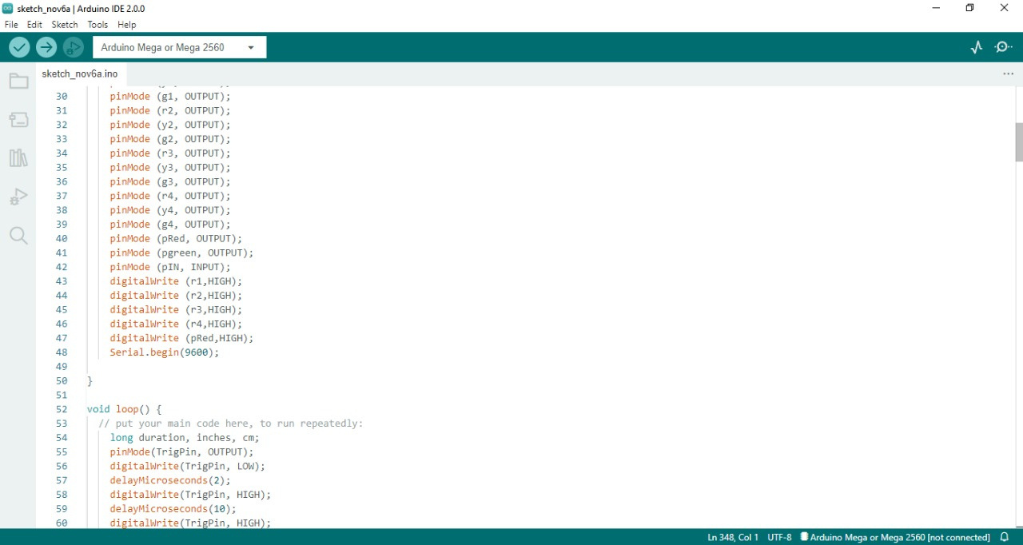

Slide 13
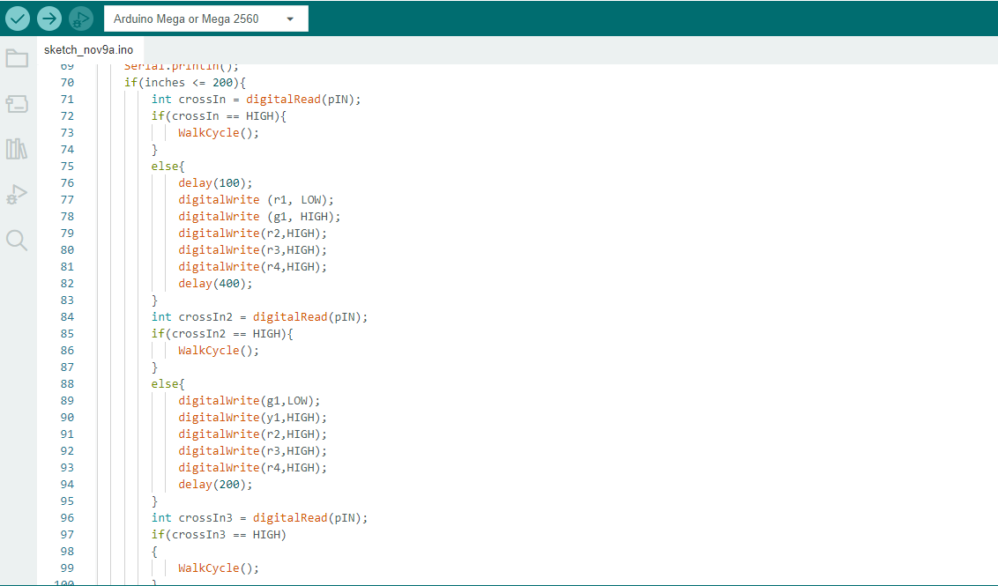

Slide 14
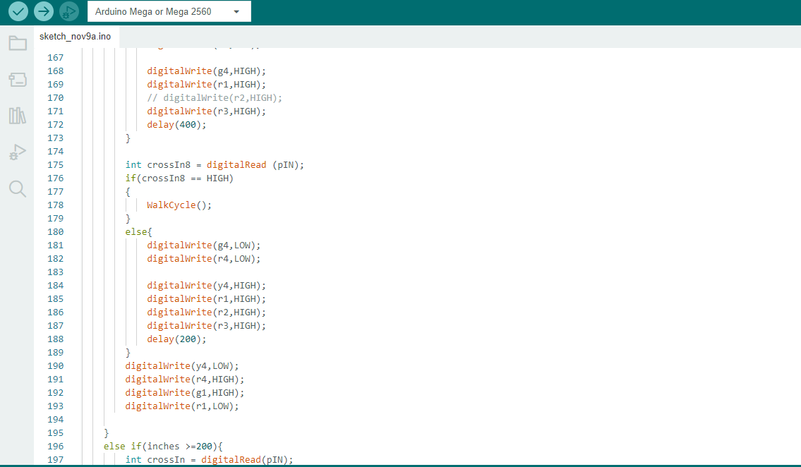

Slide 15


Slide 16
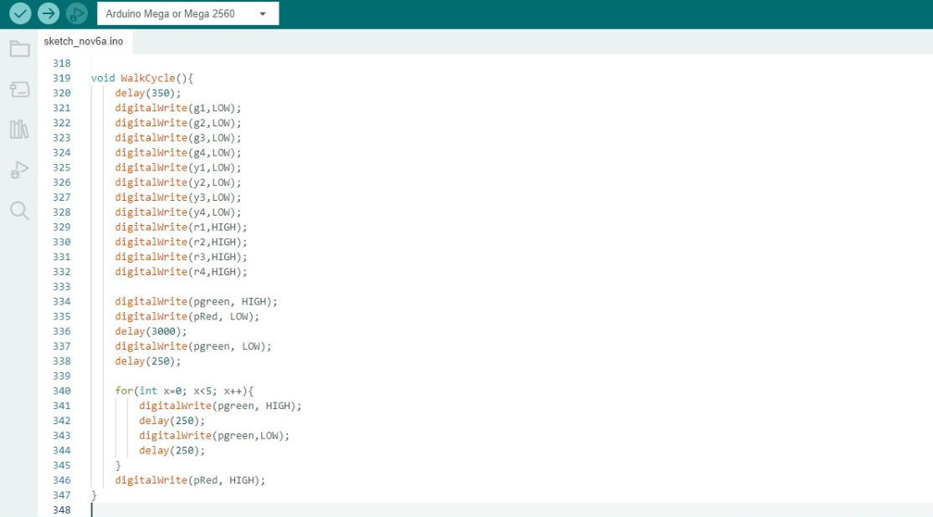

Slide 17
Thank
Thank
Thank
you!
you!
you!

